Slide 1
U.S. ARMY COMBAT CAPABILITIES DEVELOPMENT COMMAND
GROUND VEHICLE SYSTEMS CENTER
Neuromorphic Events in Military Operations (NEMO)
11 AUG 2026
Controlled by:
GVSC / GVR
Distribution Statement:
DISTRIBUTION STATEMENT A. Approved for public release; distribution is unlimited. OPSEC# (Pending, NOT approved for release)
POC:
David Pirozzo (David.m.Pirozzo.civ@army.mil)
Ryan Kreiter & Dave Pirozzo, Technical Specialists

Slide 2
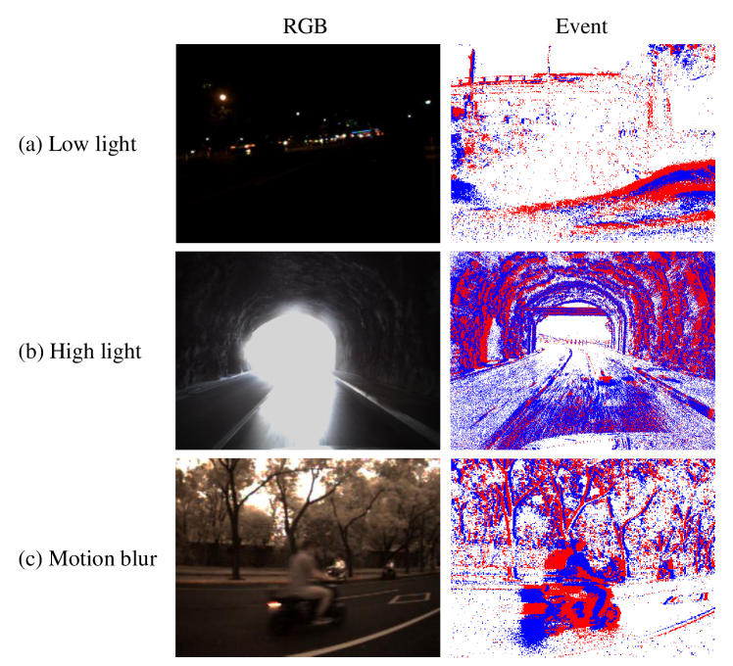
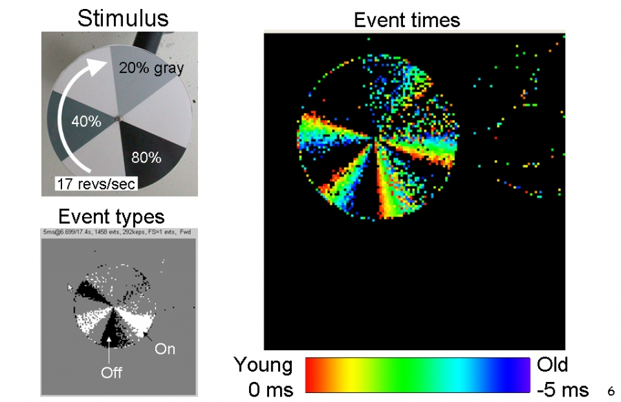
Overview
Background
Goals
Neuromorphic or Event-based cameras are retina-inspired sensor
No fixed frame rate, pixels operate independently
When illumination changes enough, an event is triggered indicating an increase or decrease
Very high dynamic range
Typically as low as 1 microsecond response time
Explore neuromorphic cameras and their numerous applications as a perception component on Army robots
Investigate how neuromorphic cameras compare to other common perception sensors and how they might combine with those sensors to provide enhanced situational awareness and perception capabilities
Explore LiFi light-based communication use case

Slide 3
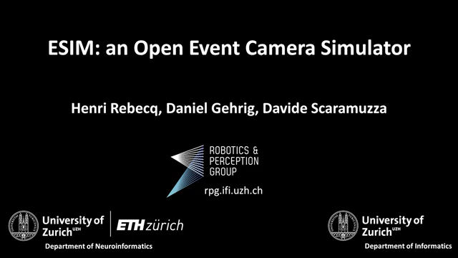
Research
DTIC Papers
  Found papers using Event cameras for visual odometry on UAS platforms.
  Found papers related to feature detection using raw event data rather than processed image data to improve performance.
Clemson University
  Built large data set including Event, EO/IR, and hyperspectral cameras, as well as RADAR and LIDAR mounted on vehicle
  Recorded data in various off-road environments
  Total of ~1.7TB of data, divided into 20GB ROS Bag files
ESIM / Unreal Simulation
  University of Zurich developed ESIM Open Event Camera Simulator. Generates events based on camera motion in 3D environment. Multiple rendering engines available.
  UnrealCV plugin allows ESIM to interface with any Unreal Engine environment. This should allow us to leverage existing GVSC environments built for ProjectGL.
  Encounted lots of compatability issues between ESIM, UnrealCV, and Unreal Engine since ESIM is no longer supported, requiring older versions of UnrealCV, Unreal Engine, and Ubuntu Linux.
  Was able to get them working together, but performance was so slow that the benefits were no longer worth the effort once camera hardware was available for live testing.

Slide 4
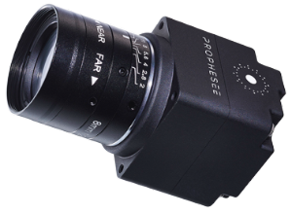
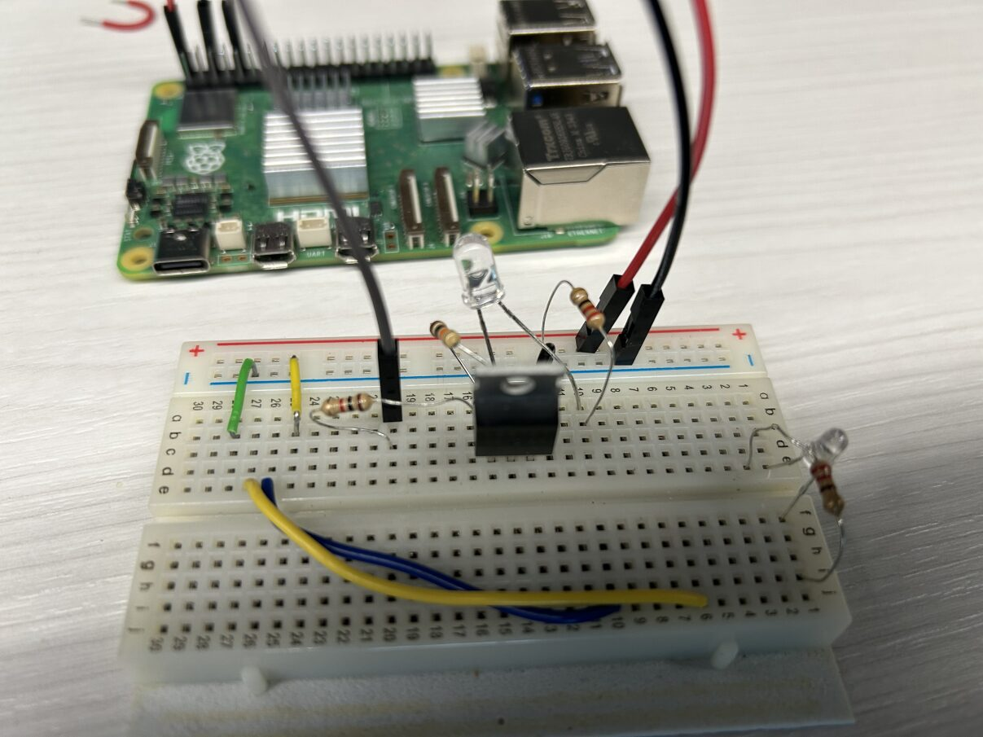
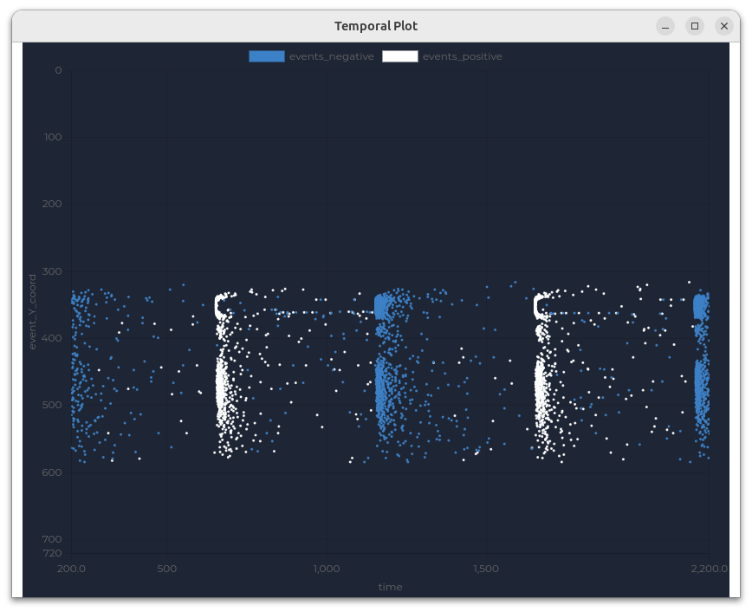
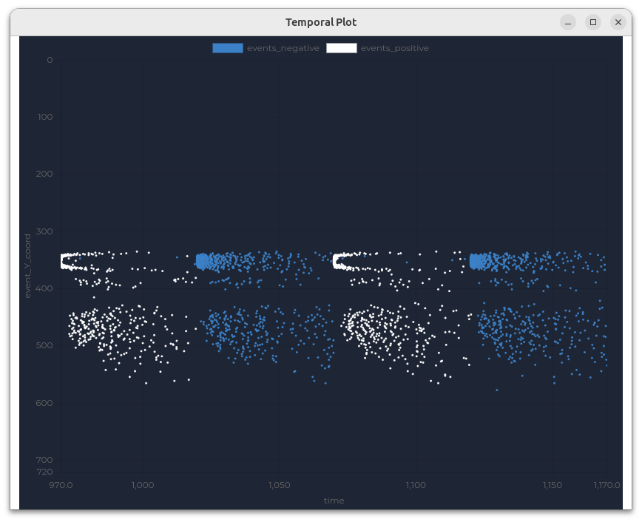
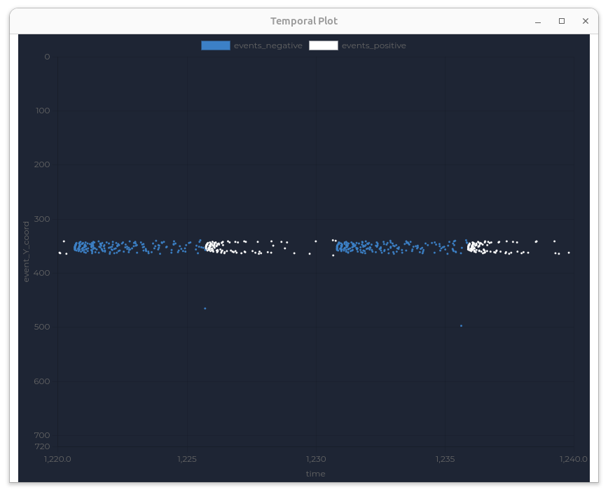
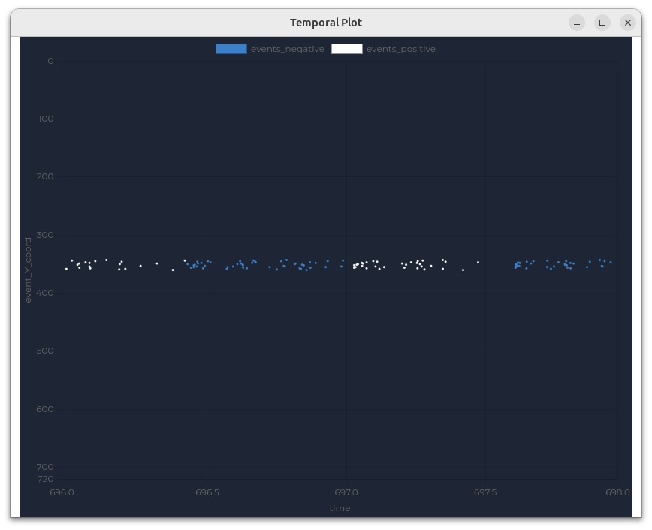
hardware
Prophesee EVK4 Camera
  1280 x 720 resolution
  30x30x36 mm
  120dB dynamic range
  ~0.5W
  Bandwidth depends on scenery
  Functional down to 0.08 lux
    (Moonlit cloudy sky typically 0.1 lux)
LED Setup and Testing
  Control LED on breadboard via GPIO from Raspberry Pi 5
  Added MOSFET to control higher power 940nm IR LED
  Camera on tripod about 2ft from LED
11 AUG 2026

Slide 5
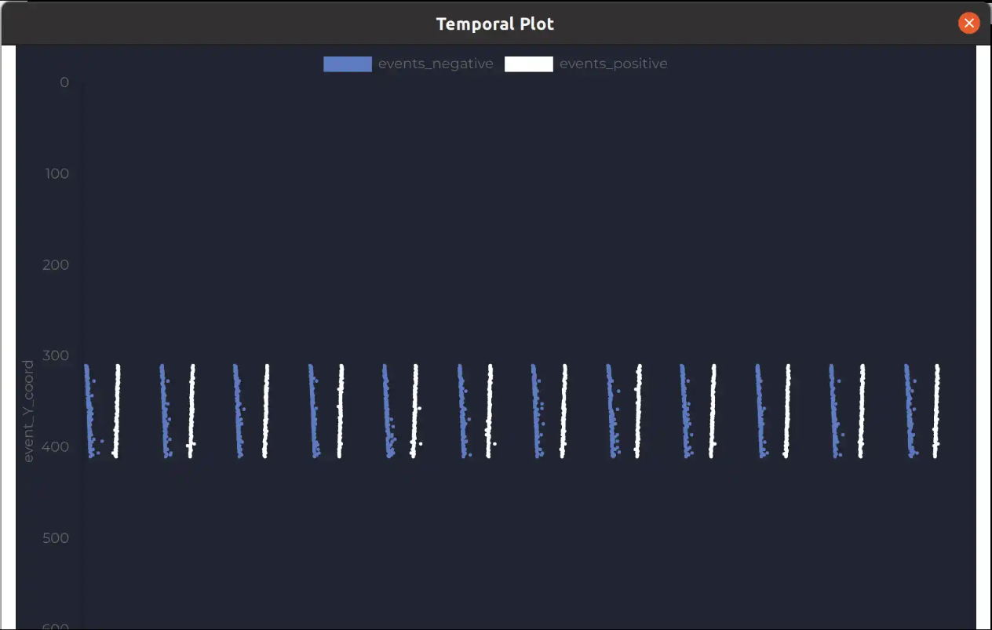
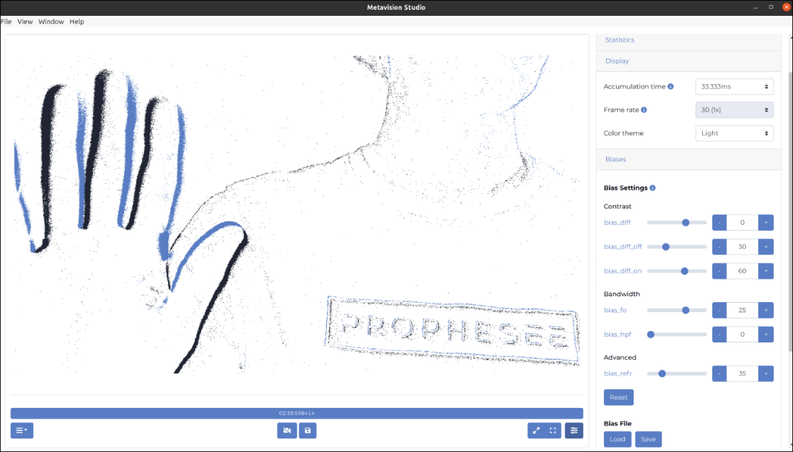
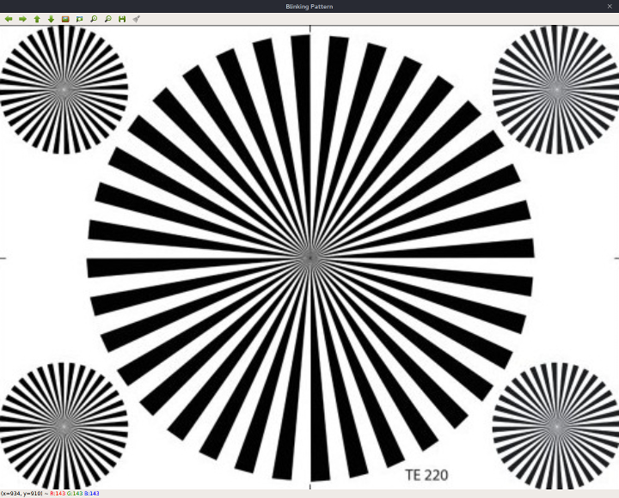
Software - METAVISION
Metavision Studio and SDK
  Vendor tools to view, record, and calibrate camera; play with settings to get better understanding of camera parameters
  ROS driver available to publish event messages (X,Y,Time,Polarity) and generate ROS image
  Parameters of interest
    Contrast sensitivity (how large of a change triggers events)
    Low pass filter (rapid illumination changes)
    High pass filter (slow illumination changes)
    Refractory period (how long to disable detection after an event)

Slide 6
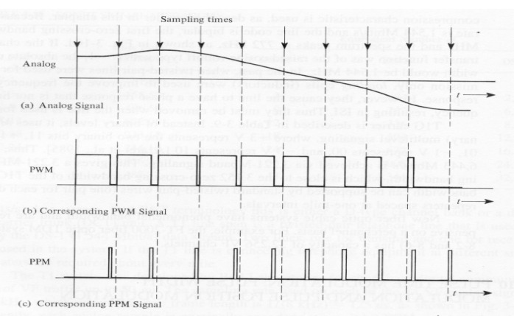
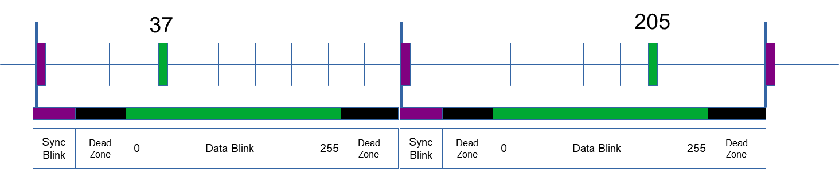
Software – LED Control
Wrote software to control LED with a Raspberry Pi
  Use WiringPi C library for fast GPIO control
  Added ability to read data from file to control the blinking pattern
  Tried multiple encoding methods:
    Binary message, light on for 1 and off for 0
    PWM-like message, keeping light on for length of time based on byte value being sent
    PPM-like message, blink light at correct time in duty cycle based on byte value being sent
Issues Encountered
  Using single LED for Sync and Data required more complex logic to distinguish which signal was which. Added dedicated Sync LED.
  Tested maximum rate of LED control by increasing commanded blink rate and measuring actual time between events seen by camera. Maximum rate of control seems to be around 6500Hz.

Slide 7


Software – led detection
Added overlay to generated images to help with aligning camera to LEDs
Created a ROS node to detect LED:
  Read in camera event data
  Count the number of positive and negative events within target region
  Use rolling window of time to accumulate events
  Evaluate whether events meet the threshold for on/off detection
  Calculate time between Sync and Data blink and convert to byte value
  Write the result to a file
Have successfully transferred a small text file at slow (20Hz) blink rate
Issues Encountered
  Camera can only detect change in light state, not current brightness
  LED blink does not have a discrete response when viewed at very high frame rate, variation in detection time causes errors in decoded data
  Blink will often result in a large number of both on and off polarity events, making it difficult to tell the state of the light.

Slide 8
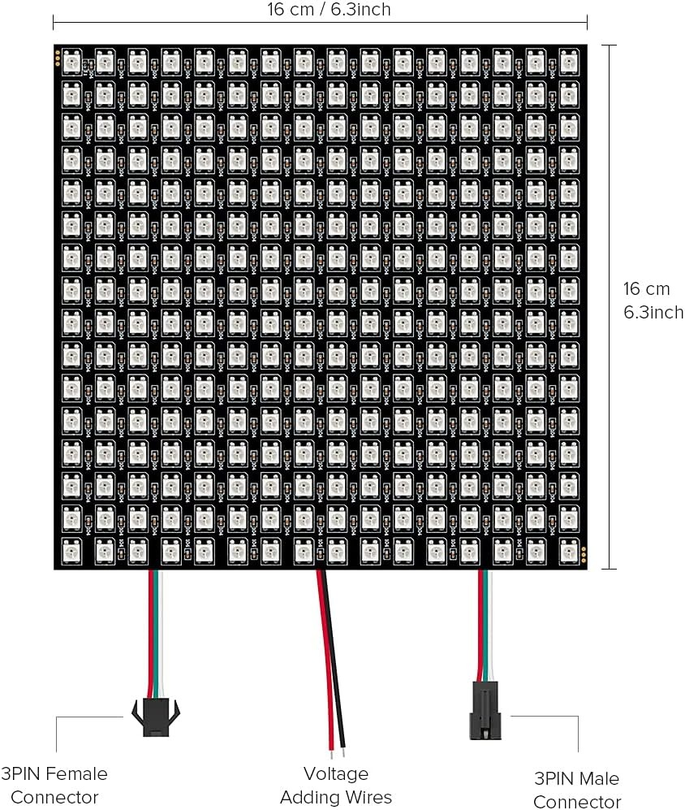
Future work / Next steps
Where do we want to go from here?
  Try multiple Data LEDs running in parallel
  Do more thorough analysis of how camera parameters affect detection rate
  Automatically detect LED locations
  Investigate training an AI model for decoding data from events
  See if Arduino can control LED at faster rate
  Test in low light conditions
Remaining issues/blockers
  Debug detection failures when increasing blink rate, need to improve detection time precision
  Detection at longer range difficult due to fewer events, try with larger LED panel
  Better logic for handling mix of simultaneous on/off events

